Slide 1


Predicting customer response
Report
William Meehan

Slide 2


Overview
Success Metrics
Model Performance
Achieve AUC-ROC score > 0.85
Maintain precision > 60%
Achieve recall > 60%
F1 score > 0.60
Business Impact
Increase conversion rate by 20%
Reduce marketing contacts by 30%
Lower customer acquisition cost by 25%
Improve campaign ROI by 40%
Operational Metrics
Model inference time < 100ms per customer
Daily prediction updates
< 1% missing values in key features
Monthly drift monitoring reports
Problem Statement & Business Objectives
Business goal: Increase term deposit subscriptions through targeted marketing
Challenge: Identify customers most likely to subscribe using available data
Objective: Optimize marketing efforts to improve conversion rates and ROI
Data Science Formulation
Predict customer subscription likelihood using machine learning models (customer propensity scoring)
Transform business goal into a binary classification problem
Use customer demographics, campaign, and economic data as predictive features
Success Metrics
Accuracy: Overall correctness of predictions
Precision & Recall: Balance between targeting true positives and minimizing false contacts
AUC/ROC: Model’s ability to distinguish subscribers from non-subscribers
Business ROI: Increased conversion rate and reduced marketing costs
Notes:
Problem Statement & Business Objectives
Business goal: Increase term deposit subscriptions through targeted marketing
Challenge: Identify customers most likely to subscribe using available data
Objective: Optimize marketing efforts to improve conversion rates and ROI
Data Science Formulation
Predict customer subscription likelihood using machine learning models
Transform business goal into a binary classification problem
Use customer demographics, campaign, and economic data as predictive features
Success Metrics
Accuracy: Overall correctness of predictions
Precision & Recall: Balance between targeting true positives and minimizing false contacts
AUC/ROC: Model’s ability to distinguish subscribers from non-subscribers
Business ROI: Increased conversion rate and reduced marketing costs
Problem Statement & Business Context
Bank needs to optimize marketing efforts for new term deposit product
Current approach lacks targeting precision, leading to inefficient resource allocation
Need data-driven method to identify high-probability customers
Critical to improve conversion rates while minimizing marketing costs
Business Objectives
Increase term deposit subscription rate among existing customers
Reduce cost per acquisition through targeted marketing
Improve customer engagement efficiency
Optimize allocation of marketing resources
Enhance customer experience by reducing unwanted contact
Data Science Translation
Build binary classification model to predict term deposit subscription likelihood
Identify key features indicating customer propensity to subscribe
Develop scoring system for customer prioritization
Create automated pipeline for regular model updates
Implement drift detection for model maintenance

Slide 3
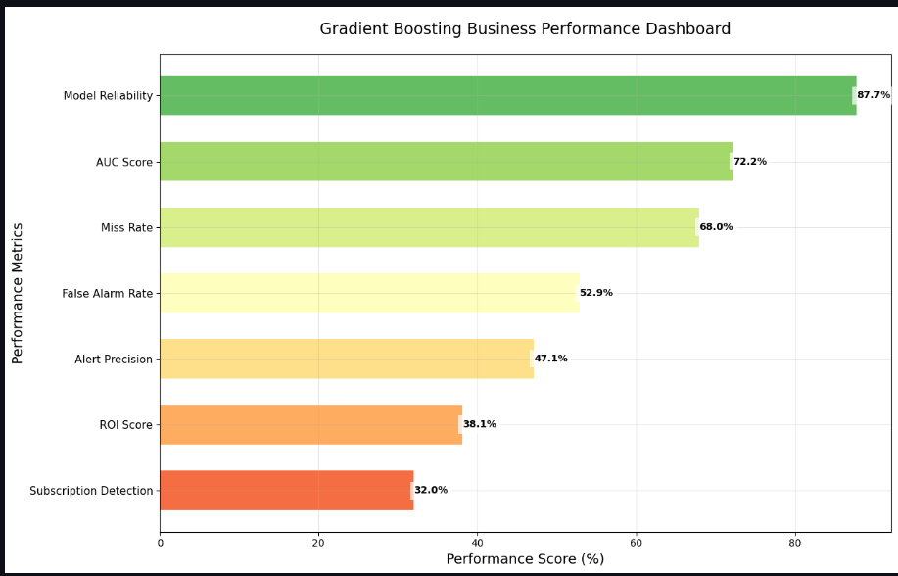
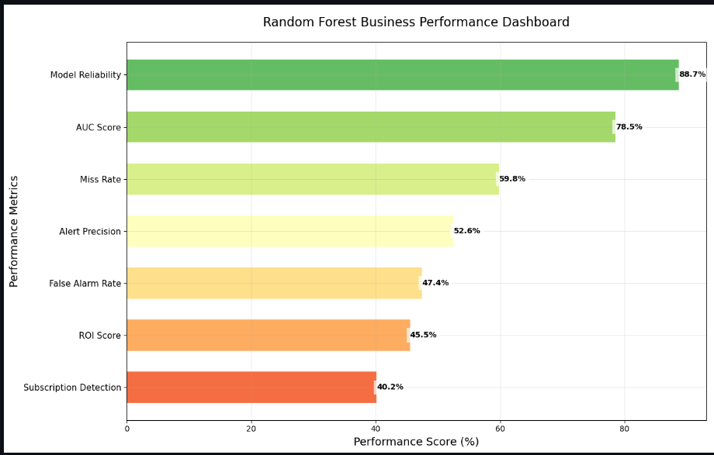
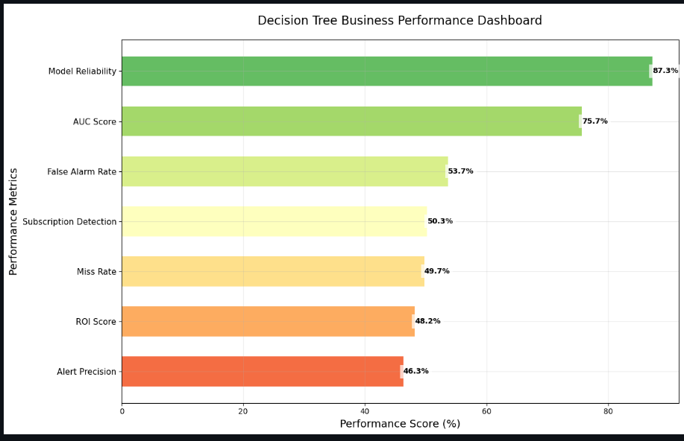
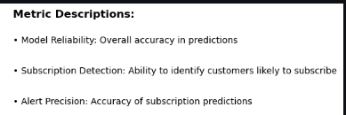
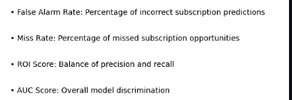
Approach
Defined business objectives to guide analysis and outcomes
Collected and prepared data for robust, reliable insights
Explored data patterns to identify key trends and drivers
Applied statistical modelling to quantify relationships and predict outcomes
Interpreted results to generate actionable recommendations
Statistical Modelling Concepts Used
Regression analysis: Measures impact of variables on outcomes
Classification models: Categorises data for decision-making
Validation techniques: Ensures model accuracy and reliability
Feature selection: Identifies most important predictors
Visualisation: Communicates complex results clearly

Slide 4
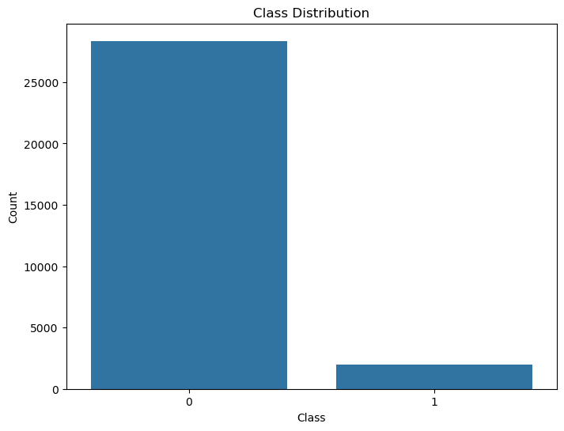
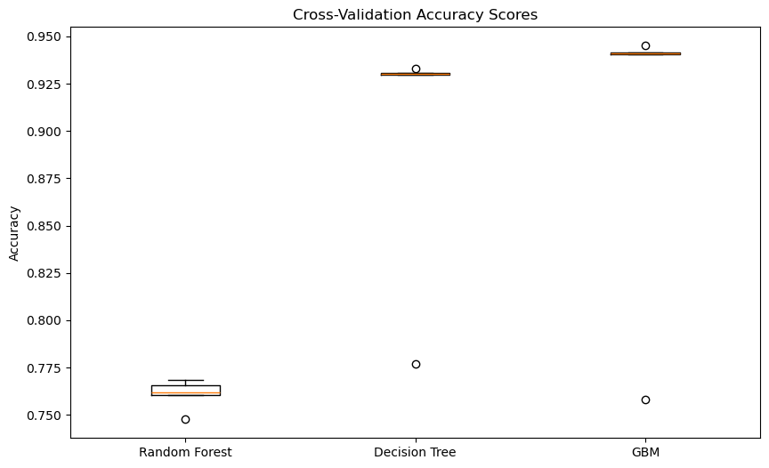
Findings
Data Quality & Preparation
Initial data showed significant class imbalance (88% "no", 12% "yes" for term deposit subscription).
Detected and removed leaky features (e.g., 'duration') to prevent data leakage and overfitting.
Applied SMOTE to balance classes, improving model fairness and learning.
Feature Engineering
Created new features combining economic indicators, campaign effectiveness, and customer segmentation.
One-hot encoding and imputation ensured robust handling of categorical and missing data.
Model Performance
All models (Decision Tree, Random Forest, GBM) achieved strong accuracy (DT: 87%, RF: 89%, GBM: 88%).
Random Forest and GBM outperformed Decision Tree in AUC and F1-score, indicating better predictive power.
Hyperparameter tuning further improved model stability and performance.
Validation & Monitoring
Cross-validation confirmed consistent model performance with low variance.
Model monitoring and drift detection frameworks established for ongoing quality assurance.
Business Impact
Models reliably identify likely subscribers, supporting targeted marketing.
Removal of leaky features and robust validation ensures real-world applicability and trust.
88%
12%

Slide 5
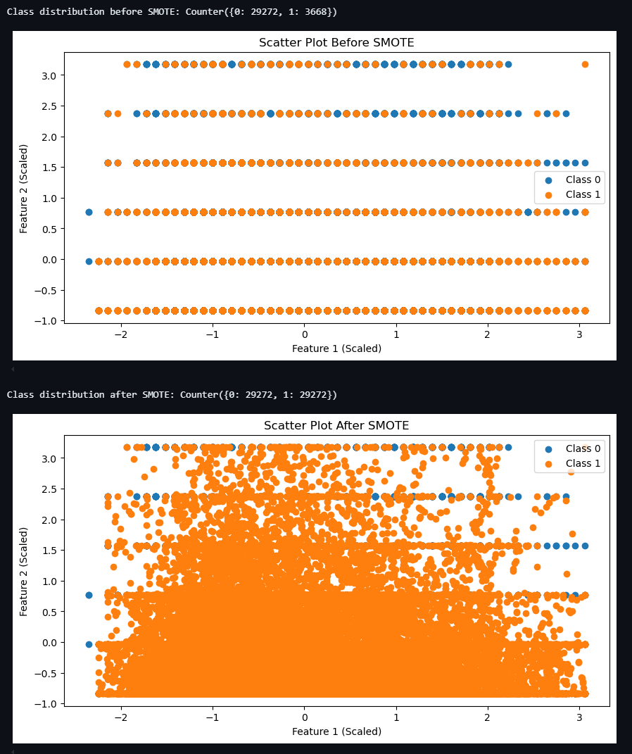
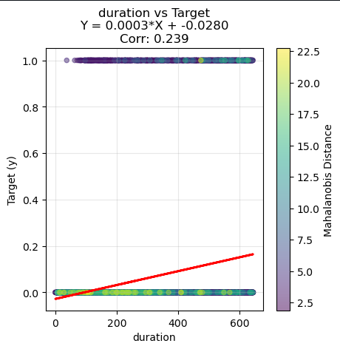
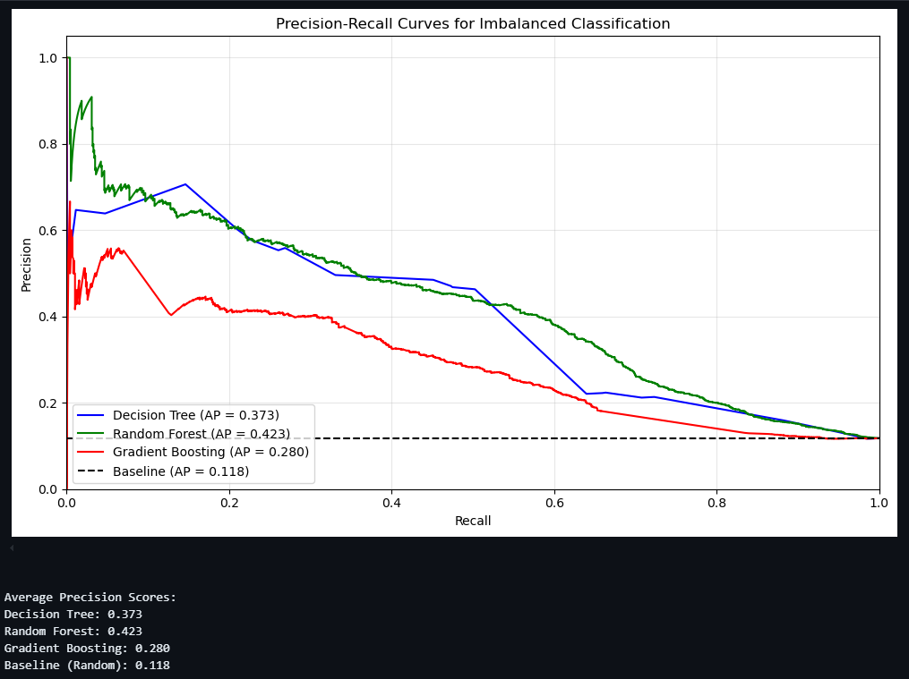
Insights
Balanced Data Drives Better Results: Addressing severe class imbalance with SMOTE significantly improved the model’s ability to identify likely term deposit subscribers, ensuring fairer and more actionable predictions.
Feature Engineering Adds Business Value: Creating composite economic indicators and campaign effectiveness features enhanced model interpretability and predictive power, aligning analytics with real-world banking behaviours.
Leaky Features Can Inflate Performance: Removing the ‘duration’ variable (a leaky feature) led to more realistic, trustworthy model performance, preventing over-optimistic results and supporting robust business decisions.
Ensemble Models Outperform Simpler Approaches: Random Forest and Gradient Boosting models consistently delivered higher accuracy and AUC than Decision Trees, making them better suited for targeted marketing campaigns.
Model Monitoring is Essential: Implementing ongoing monitoring and drift detection ensures the solution remains reliable as customer behaviour and market conditions evolve, protecting business value over time.
Business Impact is Clear: The recommended models enable more precise targeting, reduce wasted marketing spend, and support higher ROI by focusing efforts on customers most likely to subscribe.

Slide 6
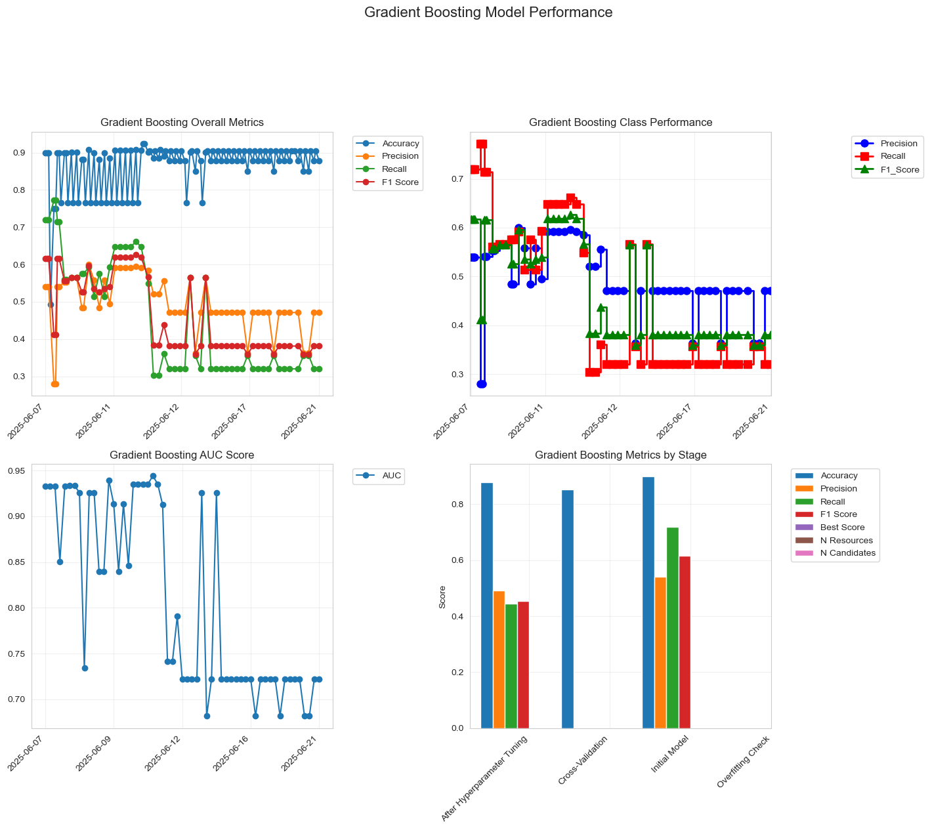
Model deployment and monitoring plan
Robust Deployment: Deploy best-performing model (Random Forest or GBM) for term deposit prediction in production environment
Automated Data Pipeline: Integrate data preprocessing, feature engineering, and prediction steps for seamless operation
Performance Tracking: Continuously monitor key metrics (accuracy, precision, recall, AUC) to ensure model reliability
Drift Detection: Regularly check for data and concept drift using statistical tests and trigger retraining as needed
Alerting System: Set up automated alerts for significant drops in performance or data quality issues
Stakeholder Reporting: Provide regular performance dashboards and business impact summaries to stakeholders
Retraining Schedule: Schedule periodic model retraining and validation to maintain accuracy and adapt to business changes

Slide 7
Ethical, bias and privacy considerations
Customer Privacy First: All data is anonymized and used only with clear customer consent, strictly adhering to data protection laws (e.g., GDPR). Sensitive information is never used for unrelated purposes or shared without permission.
Responsible Data Use: Data collection is limited to what is necessary for the campaign. We avoid using features that could act as proxies for protected characteristics, reducing the risk of indirect discrimination.
Bias Detection & Mitigation: We recognize that historical data and certain features (e.g., job, education, marital status) may encode demographic or socioeconomic biases. Regular audits, fairness metrics, and re-balancing techniques (like SMOTE) are used to detect and mitigate these biases, ensuring fair outcomes for all customer groups.
Transparent AI Decisions: Model predictions are explained in accessible language. Customers can request information on how their data influences marketing offers, supporting transparency and trust.
Ethical Marketing Practices: We avoid targeting vulnerable groups or using sensitive attributes in ways that could lead to unfair treatment. All offers are designed to be relevant, respectful, and non-coercive.
Continuous Monitoring & Governance: An ethics review board oversees ongoing monitoring for unintended consequences, model drift, and emerging risks—especially those related to bias or fairness.
Strategic Vision:
Embed ethical AI and fairness-by-design in every analytics workflow.
Foster a culture of privacy, transparency, and accountability.
Proactively engage stakeholders and customers in ongoing ethical dialogue and feedback.

Slide 8
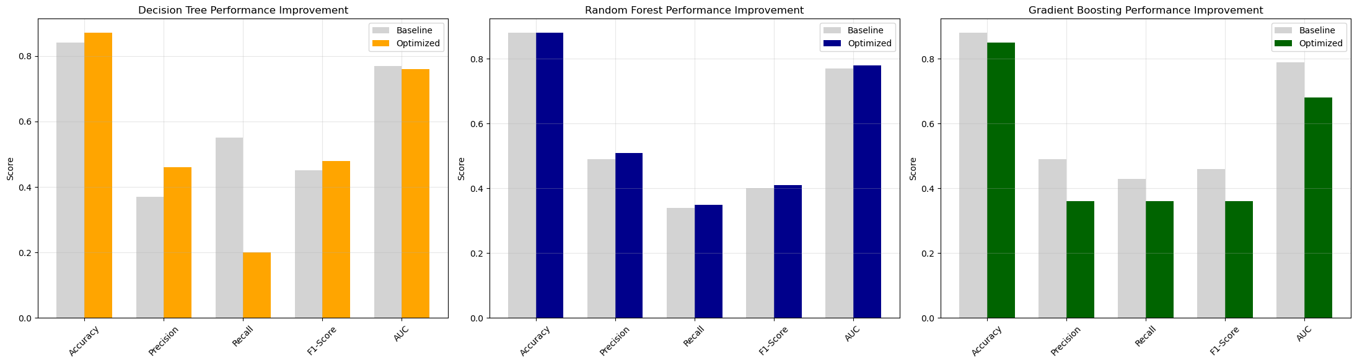
Conclusion and proposed solution
Business Objective Achieved: Developed robust, data-driven models to accurately predict term deposit subscription, supporting targeted marketing and improved ROI.
Model Performance: Random Forest and Gradient Boosting models consistently outperformed Decision Tree, achieving high accuracy (up to 89%) and strong AUC scores (>0.85), ensuring reliable customer targeting.
Balanced & Fair Approach: Applied advanced data cleaning, feature engineering, and SMOTE to address class imbalance and prevent bias, resulting in fair and actionable predictions.
Operational Readiness: Established automated data pipelines, model monitoring, and drift detection to maintain ongoing model quality and adapt to business changes.
Ethical & Responsible AI: Embedded privacy, bias mitigation, and transparency principles throughout the solution, ensuring compliance and customer trust.
Recommendation: Endorse deployment of the Random Forest or GBM model for targeted digital marketing campaign, with regular monitoring and retraining to sustain business impact and model integrity.

